Slide 1

Auditor | 이혜진 | Audit Date | 19/04/02 | Server | KR | Language | 영문 | WCAG No. | 1.1.1 Non-text Content
Menu | Receipt_EN (Domestic) |  |  |  |  |  | ETC
URL | https://pns.koreanair.com/pns/pns04/pns040202.do?bprd=100010ABEF658885688C34E00838512E1561476F7E13AEBE7B06FA9202FB61AE5A6769D342A9633A0B5D0D9BC4CF316902AFF943F18C0E47A586E258D618588D678F0D
Issue | 이미지 alt값이 적절치 않음 (50 주년 내용 누락됨)
Modification | alt="Korean Air. SkyTeam. 50 years“로 수정

Slide 2
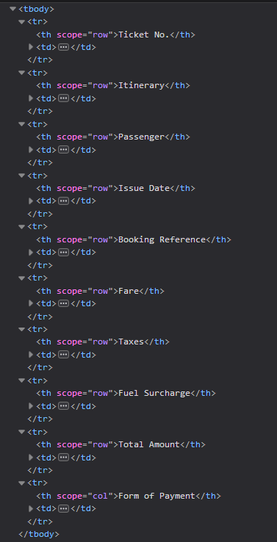
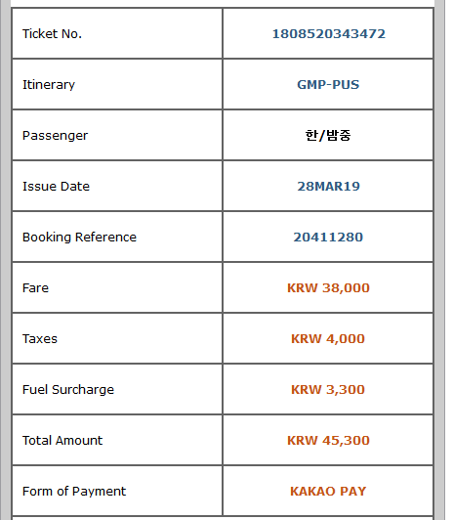
Auditor | 이혜진 | Audit Date | 19/04/02 | Server | KR | Language | 영문 | WCAG No. | 1.3.1 Info and Relationships
Menu | Receipt_EN (Domestic) |  |  |  |  |  | ETC
URL | https://pns.koreanair.com/pns/pns04/pns040202.do?bprd=100010ABEF658885688C34E00838512E1561476F7E13AEBE7B06FA9202FB61AE5A6769D342A9633A0B5D0D9BC4CF316902AFF943F18C0E47A586E258D618588D678F0D
Issue | 제목열 scope 속성이 잘못 됨
Modification | scope=row로 수정

